Slide 1

Where to Find Ethnic Cuisines in Toronto An IBM Data Science Capstone Project
iNah Canlapan
December 2019

Slide 2

Introduction & Business Problem
Toronto is one of the most multicultural cities in North America. There is a vast selection of cuisine available to you wherever you are in the city.
If you're craving Italian food, where should you go? Where should you go if you want Chinese food?
This analysis aims to cluster restaurants based on the type of cuisine so you know where to go if you're looking for a specific type of food.

Slide 3
Data Requirements
This project will use the Foursquare API to pull data like:
Venue Name
Venue Location (Latitude & Longitude)
Venue Category
Cuisine was derived from the Venue Category data, with focus on ethnicity. Venues categorized into generic food categories like "Burgers" or "Coffee Shop" are excluded.
Other data leveraged include data from Wikipedia on Toronto's Boroughs and location data (longitude and latitude).

Slide 4
Methodology
Use Wikipedia and Geospatial data to pull location details of of the city - ie: Latitude, Longitude
Use Foursquare data to pull Venue data
Use k-means to cluster restaurants based on type of cuisine

Slide 5
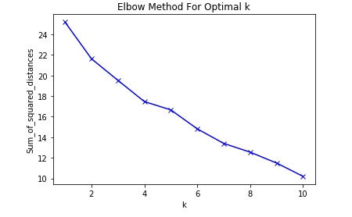
Results Determining k in the k-means algorithm
The Elbow Method was used to determine the optimal k.
While there is no clear elbow like one would expect, we can see that the sum of squared distances has the flattest slope at k = 5. Thus, 5 clusters were generated using the k-means algorithm.

Slide 6
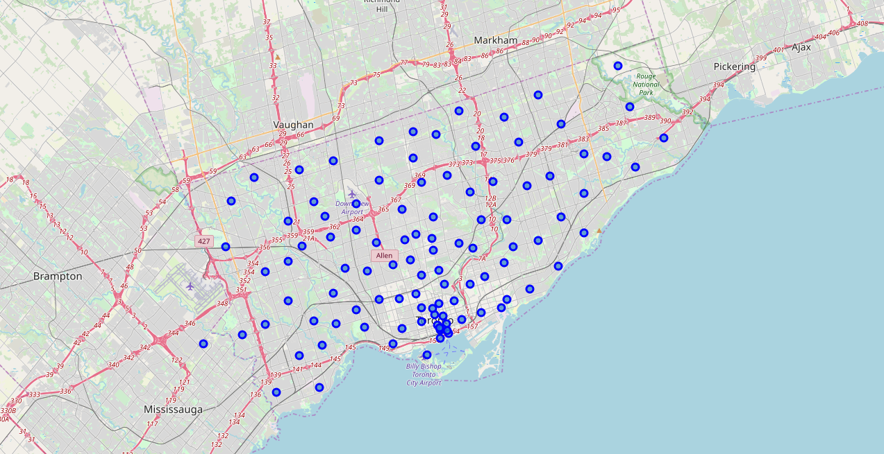
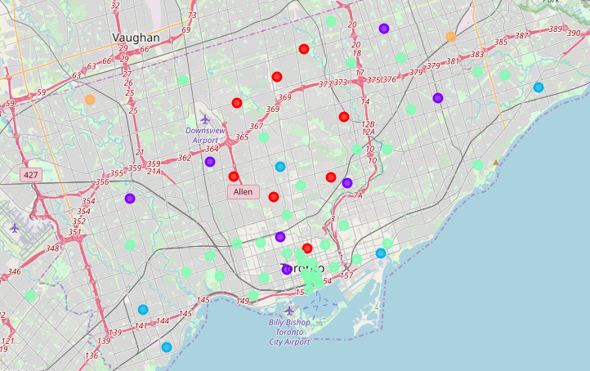
Results Clustering Neighbourhoods
There are 103 neighbourhoods in the Toronto data set from Wikipedia.
After selecting neighborhoods that were near ethnic restaurants, 60 neighborhoods remained and were clustered.
Before clustering
After clustering

Slide 7
Discussion Cluster 1: Japanese Restaurants North of the Downtown Core
Borough | Neighbourhood | Restaurants
Central Toronto | Forest Hill North,Forest Hill West | Nikko Sushi Japenese Restaurant
Downtown Toronto | Church and Wellesley | Kawa Sushi, Onnki Donburi, Okonomi House, Kokoni Izakaya, Sansotei Ramen, Tokyo Sushi, Wow! Sushi, Sushi Box, Rolltation, Asahi Sushi
East York | Leaside | Kintako Japanese Restaurant
North York | Bathurst Manor,Downsview North,Wilson Heights | Wakame Sushi
North York | Bayview Village | Kaga Sushi
North York | Don Mills North | Gonoe Sushi
North York | Glencairn | Miyako Sushi Restaurant
North York | Willowdale South | Wako Sushi + Bar, Konjiki Ramen, KINTON RAMEN, Ajisen Ramen, Aburi Room, Ichiban Sushi House, PROJECT:FISH

Slide 8
Discussion Cluster 2: Chinese Restaurants
Borough | Neighbourhood | Restaurants
Downtown Toronto | Chinatown,Grange Park,Kensington Market | Swatow Restaurant, New Sky Restaurant, Rosewood Chinese Cuisine, House of Gourmet, Asian Legend, Dim Sum King Seafood Restaurant, Dumpling House, Juicy Dumpling, Yummy Yummy Dumpling, Mother's Dumplings
Etobicoke | Westmount | Mayflower Chinese Food
Scarborough | Dorset Park,Scarborough Town Centre,Wexford Heights | Kim Kim restaurant
Scarborough | L'Amoreaux West | Mr Congee Chinese Cuisine, Phoenix Restaurant

Slide 9
Discussion Cluster 3: Mexican Restaurants
Borough | Neighbourhood | Restaurants
Central Toronto | North Toronto West | Tio's Urban Mexican
East Toronto | Business Reply Mail Processing Centre 969 Eastern | Chino Locos
Etobicoke | Humber Bay Shores,Mimico South,New Toronto | Hex-Mex
Etobicoke | Kingsway Park South West,Mimico NW,The Queensway West,Royal York South West,South of Bloor | Burrito Boyz
Scarborough | Guildwood,Morningside,West Hill | Big Bite Burrito

Slide 10
Discussion Cluster 4: Japanese & Italian Restaurants in the Downtown Core
Italian
Borough | Neighbourhood | Restaurants
Downtown Toronto | Adelaide,King,Richmond | Mercatto
North York | Bedford Park,Lawrence Manor East | Francobollo,Il Fornaro
Downtown Toronto | Berczy Park | The Old Spaghetti Factory
West Toronto | Brockton,Exhibition Place,Parkdale Village | Caffino
Downtown Toronto | Cabbagetown,St. James Town | F'Amelia, Hey Lucy
Downtown Toronto | Central Bay Street | Mercatto, Scaddabush Italian Kitchen & Bar, Sambuca Grill, Tosto
Downtown Toronto | Christie | Vinny’s Panini
Scarborough | Clarks Corners,Sullivan,Tam O'Shanter | Remezzo Italian Bistro
Downtown Toronto | Commerce Court,Victoria Hotel | Mercatto, Terroni, Carisma
Central Toronto | Davisville | Florentia Ristorante, Positano
Downtown Toronto | Design Exchange,Toronto Dominion Centre | Amano Pasta, Scaddabush Italian Kitchen & Bar, TOCA, Mercatto
Downtown Toronto | First Canadian Place,Underground city | Mercatto
North York | Flemingdon Park,Don Mills South | Sorento Restaurant
Downtown Toronto | Harbord,University of Toronto | Piano Piano, Daddyo's
Downtown Toronto | Harbourfront | Archeo
Downtown Toronto | Harbourfront East,Toronto Islands,Union Station | Taverna Mercatto, Amano Pasta, Piazza Manna, Aria Ristorante
West Toronto | High Park,The Junction South | nodo
West Toronto | Little Portugal,Trinity | Ufficio
West Toronto | Parkdale,Roncesvalles | Domani Restaurant & Wine Bar
Downtown Toronto | Queen's Park | Mercatto
West Toronto | Runnymede,Swansea | Campo, Goodfellas Wood Oven Pizza
Downtown Toronto | Ryerson,Garden District | Trattoria Mercatto, Scaddabush Italian Kitchen & Bar
Downtown Toronto | St. James Town | Terroni, La Bettola Di Terroni, Mercatto
Downtown Toronto | Stn A PO Boxes 25 The Esplanade | Carisma, The Old Spaghetti Factory, Mirto
East Toronto | Studio District | Baldini, Lil' Baci
East Toronto | The Beaches West,India Bazaar | Casa di Giorgio
East Toronto | The Danforth West,Riverdale | Cafe Fiorentina, 7 Numbers

Slide 11
Discussion Cluster 4: Japanese & Italian Restaurants in the Downtown Core
Japanese
Borough | Neighbourhood | Restaurants
Downtown Toronto | Adelaide,King,Richmond | Fune Japanese Restaurant,Hakata Ikkousha Ramen, JaBistro, Tachi, Yuzu No Hana
North York | Bedford Park,Lawrence Manor East | Sakura Garden
Downtown Toronto | Berczy Park | Chotto Matte
Downtown Toronto | Cabbagetown,St. James Town | Kingyo Toronto
Downtown Toronto | Central Bay Street | Rolltation, Gyubee Japanese Grill, Omai, Sansotei Ramen, Japango
Downtown Toronto | Commerce Court,Victoria Hotel | Ki Modern Japanese + Bar, Chotto Matte
Central Toronto | Davisville | Sakae Sushi, Hokkaido Sushi
Central Toronto | Deer Park,Forest Hill SE,Rathnelly,South Hill,Summerhill West | Daeco Sushi
Downtown Toronto | Design Exchange,Toronto Dominion Centre | Ki Modern Japanese + Bar, Chotto Matte
North York | Fairview,Henry Farm,Oriole | Heart Sushi, Yoi
Downtown Toronto | First Canadian Place,Underground city | Ki Modern Japanese + Bar, Chotto Matte, Fune Japanese Restaurant, Tachi
North York | Flemingdon Park,Don Mills South | Memories of Japan
Downtown Toronto | Harbord,University of Toronto | Yasu, Gyubee, Akai Sushi
Downtown Toronto | Harbourfront East,Toronto Islands,Union Station | Miku, Gonoe Sushi Japanese Restaurant
Downtown Toronto | Queen's Park | Sushi Box, Tokyo Sushi
West Toronto | Runnymede,Swansea | Asa Sushi, Yumi Sushi
Downtown Toronto | Ryerson,Garden District | Kinka Izakaya Original, Hokkaido Ramen Santouka, Kinton Ramen, Spring Sushi
Downtown Toronto | St. James Town | Gyu-Kaku Japanese BBQ, NAMI
Downtown Toronto | Stn A PO Boxes 25 The Esplanade | Chotto Matte, Ki Modern Japanese + Bar, NAMI
East Toronto | The Beaches West,India Bazaar | O Sushi

Slide 12
Discussion Cluster 5: Latin American Restaurants
Borough | Neighbourhood | Restaurants
North York | Agincourt | El Pulgarcito
Scarborough | Humber Summit | The Famous Mama Mia

Slide 13
Conclusion
The clusters defined above give some guideline as to where you need to go if you're looking for a specific type of ethnic cuisine.
These are only a small sample of the kinds of food the city has to offer!

